Slide 1
Image Generation using GAN – Short Story Assignment
Aman Shah(015944279)

Slide 2
Table of content
Introduction
Basic Architecture
Generator
Discriminator
GAN Training
Demo

Slide 3
Introduction
Annual revenue growth

Slide 4
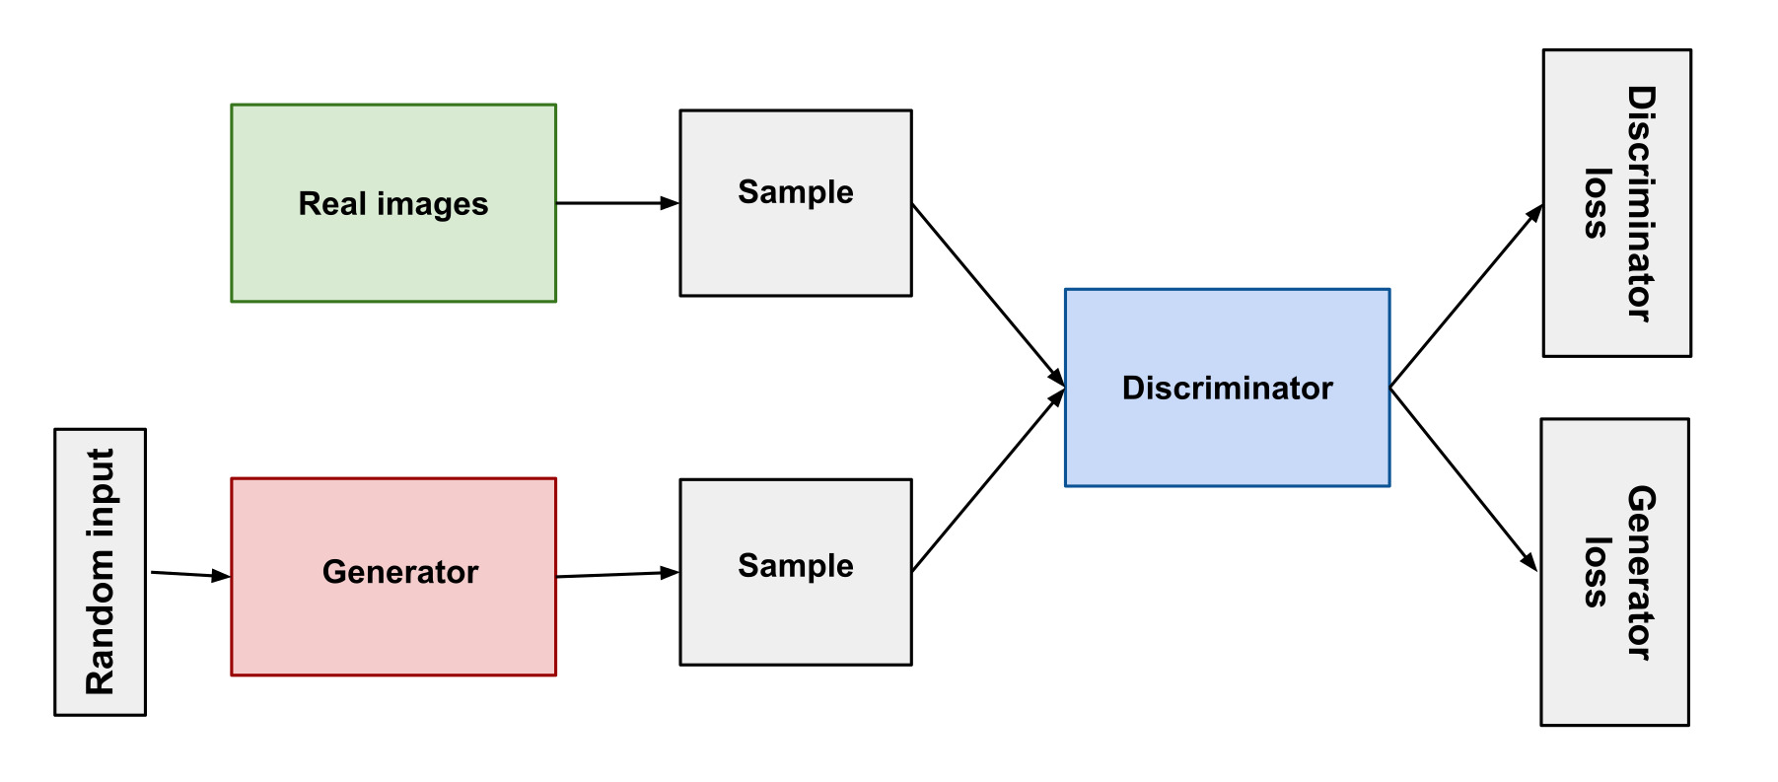
Basic architecture
At Contoso, we empower organizations to foster collaborative thinking to further drive workplace innovation. By closing the loop and leveraging agile frameworks, we help business grow organically and foster a consumer-first mindset.​

Slide 5
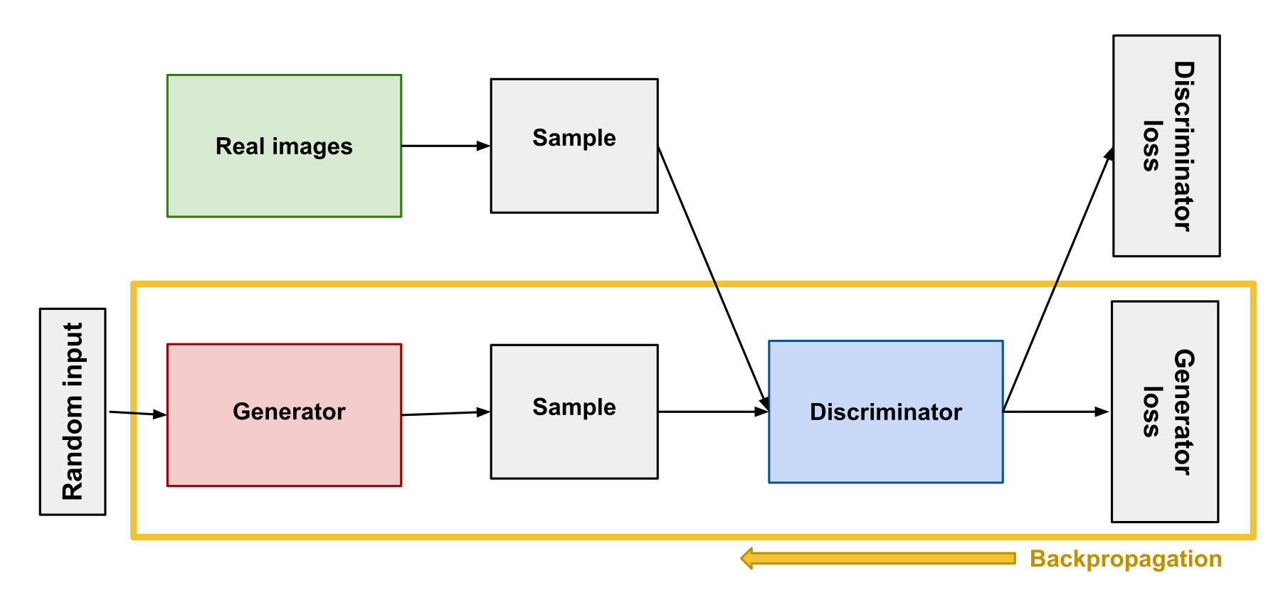
Generator
At Contoso, we empower organizations to foster collaborative thinking to further drive workplace innovation. By closing the loop and leveraging agile frameworks, we help business grow organically and foster a consumer-first mindset.​

Slide 6
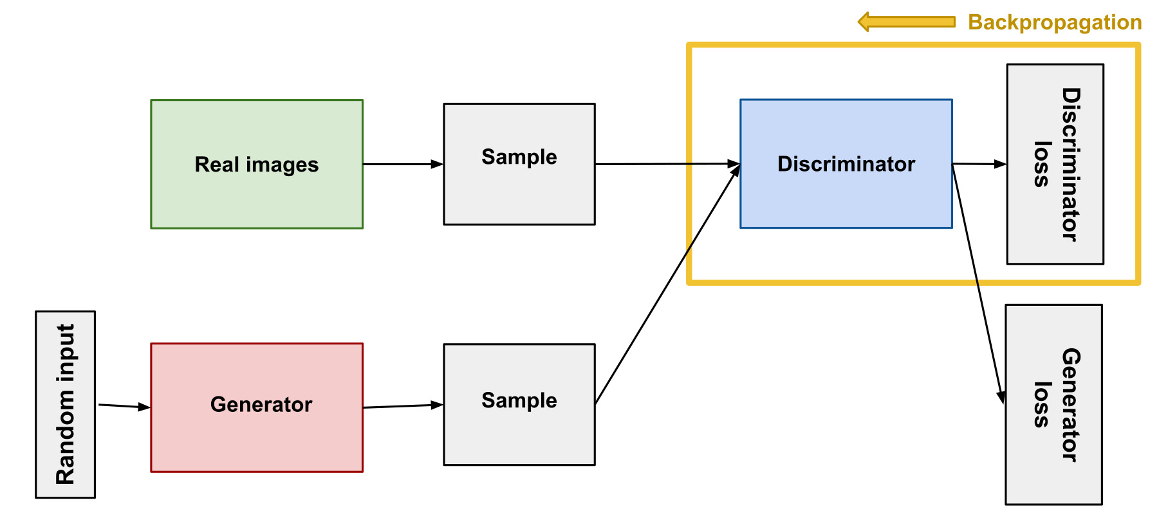
Discriminator
At Contoso, we empower organizations to foster collaborative thinking to further drive workplace innovation. By closing the loop and leveraging agile frameworks, we help business grow organically and foster a consumer-first mindset.​

Slide 7
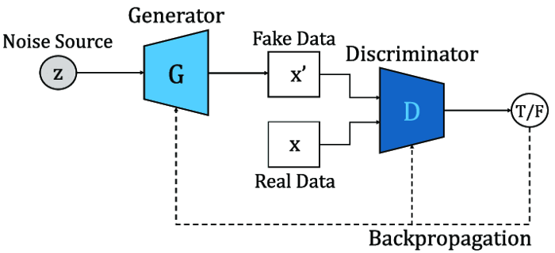
GAN Training
At Contoso, we empower organizations to foster collaborative thinking to further drive workplace innovation. By closing the loop and leveraging agile frameworks, we help business grow organically and foster a consumer-first mindset.​

Slide 8
Demo

Slide 9
THANK YOU
Aman Shah(015944279)
aman.shah@sjsu.edu

